Slide 1
Copyright & Plagiarism in Research
What every student needs to know!
Mary Ann Jones
Associate Professor
University Libraries

Slide 2
Definitions from Dictionary.com
Copyright:
the exclusive right to make copies, license, and otherwise exploit a literary, musical, or artistic work, whether printed, audio, video, etc.
(In other words: the law that gives you ownership over your creative material)
Plagiarism:
an act or instance of using or closely imitating the language and thoughts of another author without authorization and the representation of that author's work as one's own, as by not crediting the original author
a piece of writing or other work reflecting such unauthorized use or imitation
(in other words: you steal something that doesn’t belong to you and pass it off as your own)

Slide 3
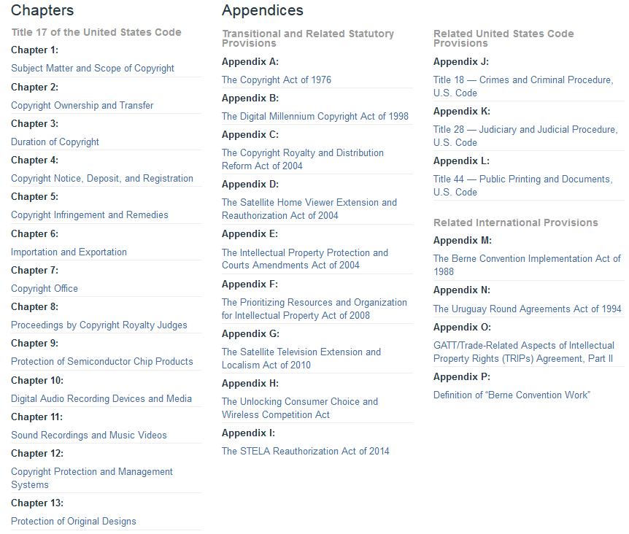
United State Code Title 17
§1-8 and §10-12 https://www.copyright.gov/title17/

Slide 4
More on copyright(s) . . .
As of 1/1/1978 copyright term is “Life + 70 years” of the author/creator
Copyright does not have to be registered with the government to be valid
You created, you own it
Unless, you want to sue for damages and/or attorney’s fees
How is a copyright different from a patent or a trademark?
Copyright does not protect facts, ideas, systems, or methods of operation

Slide 5
More on plagiarism . . .
How to avoid plagiarism:
Cite
Attribute
Give credit to
Quote
Get permission
How to check for plagiarism:
Online tools
http://www.plagiarism.org/
Citation management software (free versions available)
ASK an expert!

Slide 6
How to avoid plagiarism/copyright infringement
Plagiarism.org
Offers basic information and a list of tools to check your work
MSU Writing Center
Get help from experts
MSU Libraries’ Research Services Department
More experts to help you
The Reality and Solution of College Plagiarism Infographic
Created by the University of Illinois at Chicago Health Informatics department
The Writing Center at UNC-Chapel Hill
OWL – Purdue Online Writing Lab
UW-Madison’s Writing Center
Harvard College Writing Program

Slide 7
Citation management software
Freely available
Zotero *Library offering workshops on 2/16
Mendeley (free to MSU faculty, staff, and students)
Available for purchase (not an endorsement)
Endnote
PERRLA (APA & MLA)
Paperpile
Refworks
UW-Madison comparison chart
Wikipedia comparison chart
PlagiarismToday.com provides a list of tools to help detect plagiarism

Slide 8
Questions?
MSU Libraries resources
Research guides
Researcher Support Services Copyright & Fair Use
Other resources
Is the material Public Domain?
Copyright Clearance Center

